Slide 1
Chapter 10: Mass-Storage Systems

Slide 2
Chapter 10: Mass-Storage Systems
Overview of Mass Storage Structure
Disk Structure
Disk Attachment
Disk Scheduling
Disk Management
Swap-Space Management
RAID Structure
Stable-Storage Implementation

Slide 3
Objectives
To describe the physical structure of secondary storage devices and its effects on the uses of the devices
To explain the performance characteristics of mass-storage devices
To evaluate disk scheduling algorithms
To discuss operating-system services provided for mass storage

Slide 4
Moving-head Disk Mechanism
Tracks get bigger as you move away from the spindle…
Stay tuned…

Slide 5
Overview of Mass Storage Structure
Magnetic disks provide bulk of secondary storage of modern computers
Drives rotate at 60 to 250 times per second
Transfer rate is rate at which data flow between drive and computer
Positioning time is time to move disk arm to desired cylinder (seek time) and time for desired sector to rotate under the disk head (rotational latency)
Seek time is given in track-to-track and full-stroke measures
Head crash results from disk head making contact with the disk surface -- (That’s bad, by the way!)
Disks can be removable
Drive attached to computer via I/O bus
Busses vary, including EIDE, ATA, SATA, USB, Fibre Channel, SCSI, SAS, Firewire
Host controller in computer uses bus to talk to disk controller built into drive or storage array

Slide 6
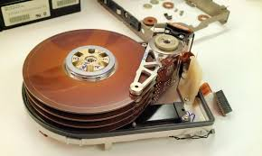
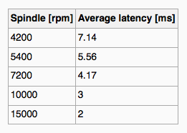
Hard Disks
Platters range from .85” to 14” (historically)
Commonly 3.5”, 2.5”, and 1.8”
Range from 30GB to 3TB per drive
Performance
Transfer Rate – theoretical – 6 Gb/sec
Effective Transfer Rate – real – 1Gb/sec
Seek time from 3ms to 12ms – 9ms common for desktop drives
Average seek time measured or calculated based on 1/3 of tracks
Latency based on spindle speed
1 / (RPM / 60) = 60 / RPM
Average latency = ½ latency
(From Wikipedia)

Slide 7
Hard Disk Performance
Access Latency = Average access time = average seek time + average latency
For fastest disk 3ms + 2ms = 5ms
For slow disk 9ms + 5.56ms = 14.56ms
Average I/O time = average access time + (amount to transfer / transfer rate) + controller overhead
For example to transfer a 4KB block on a 7200 RPM disk with a 5ms average seek time, 1Gb/sec transfer rate with a .1ms controller overhead =
5ms + 4.17ms + 0.1ms + transfer time =
Transfer time = 4KB / 1Gb/s * 8Gb / GB * 1GB / 1024²KB = 32 / (1024²) = 0.031 ms
Average I/O time for 4KB block = 9.27ms + .031ms = 9.301ms

Slide 8
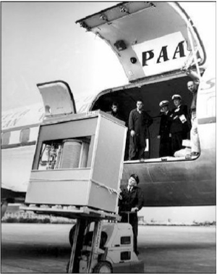
The First Commercial Disk Drive
1956
IBM RAMDAC computer included the IBM Model 350 disk storage system
5M (7 bit) characters
50 x 24” platters
Access time = < 1 second
In 1958, the system was enhanced to permit an optional additional 350 Disk Storage Unit, thereby doubling storage capacity; and an additional access arm for each 350.
Remember that we were taking about latency in milliseconds for current disk storage systems.

Slide 9
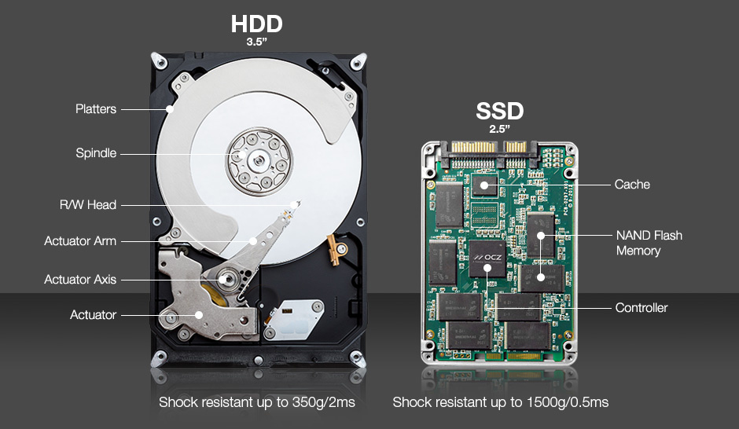
Solid-State Disks
Nonvolatile memory used like a hard drive
Many technology variations
Can be more reliable than HDDs
More expensive per MB
May have shorter life span*
Less capacity
But much faster
Standard Bus interfaces can be too slow -> connect directly to PCI (Peripheral Component Interconnect) for example
No moving parts, so no seek time or rotational latency
*this myth is overrated. Most PC SSDs will outlast other PC components.

Slide 10
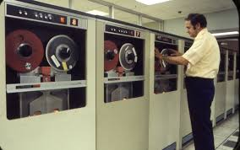
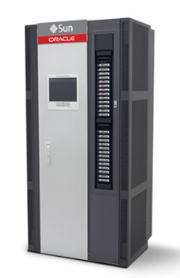
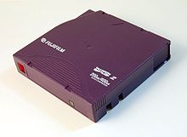
Magnetic Tape
Was early secondary-storage medium
Evolved from open spools to cartridges
Relatively permanent and holds large quantities of data
Access time slow
Random access ~1000 times slower than disk
Mainly used for backup, storage of infrequently-used data, transfer medium between systems
Kept in spool and wound or rewound past read-write head
Once data under head, transfer rates comparable to disk
140MB/sec and greater
200GB to 1.5TB typical storage
Common technologies are LTO-{3,4,5} and T10000

Slide 11
Disk Structure
Disk drives are addressed as large 1-dimensional arrays of logical blocks, where the logical block is the smallest unit of transfer
Low-level formatting creates logical blocks on physical media
The 1-dimensional array of logical blocks is mapped into the sectors of the disk sequentially
Sector 0 is the first sector of the first track on the outermost cylinder
Mapping proceeds in order through that track, then the rest of the tracks in that cylinder, and then through the rest of the cylinders from outermost to innermost
The outer tracks are ‘longer’ than the inner tracks.
Do they hold more information than do the inner tracks/cylinders?
Do they contain more sectors?

Slide 12
Track Length Variance Compensation
Constant Angular Velocity (i.e. RPM):
Non-constant # of sectors per track
decreasing bit density from in to out (to maintain constant data rate)
consistent rotation speed
Constant Linear Velocity:
Non-constant # of sectors per track
consistent bit density
increasing speed going from in to out (to maintain constant data rate)

Slide 13
Disk Attachment
Host-attached storage accessed through I/O ports talking to I/O busses
SCSI itself is a bus, up to 16 devices on one cable, SCSI initiator requests operation and SCSI targets perform tasks
Each target can have up to 8 logical units (disks attached to device controller)
FC is high-speed serial architecture
Can be switched fabric with 24-bit address space – the basis of storage area networks (SANs) in which many hosts attach to many storage units
I/O directed to bus ID, device ID, logical unit (LUN)

Slide 14
Storage Array
Can just attach disks, or arrays of disks
Storage Array has controller(s), provides features to attached host(s)
Ports to connect hosts to array
Memory, controlling software (sometimes NVRAM, etc)
A few to thousands of disks
RAID, hot spares, hot swap (discussed later)
Shared storage -> more efficiency
Features found in some file systems
Snaphots, clones, thin provisioning, replication, deduplication, etc

Slide 15
Storage Area Network
Common in large storage environments
Multiple hosts attached to multiple storage arrays - flexible

Slide 16
Storage Area Network (Cont.)
SAN is one or more storage arrays
Connected to one or more Fibre Channel switches
Hosts also attach to the switches
Storage made available via LUN Masking from specific arrays to specific servers
Easy to add or remove storage, add new host and allocate it storage
Over low-latency Fibre Channel fabric
Why have separate storage networks and communications networks?
Consider iSCSI, FCOE

Slide 17
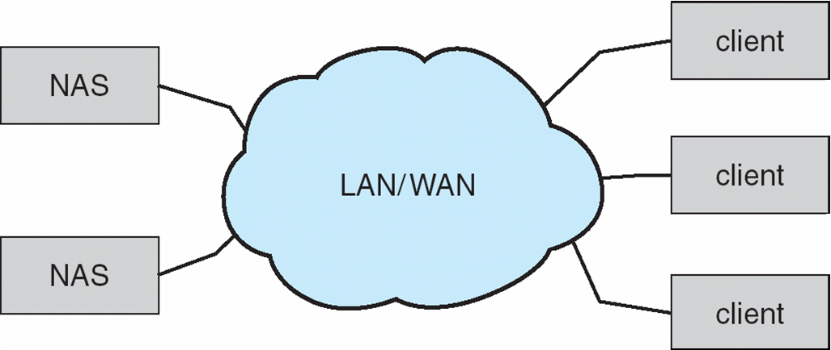
Network-Attached Storage
Network-attached storage (NAS) is storage made available over a network rather than over a local connection (such as a bus)
Remotely attaching to file systems
NFS and CIFS are common protocols
Implemented via remote procedure calls (RPCs) between host and storage over typically TCP or UDP on IP network
iSCSI protocol uses IP network to carry the SCSI protocol
Remotely attaching to devices (blocks)

Slide 18
Disk Scheduling
The operating system is responsible for using hardware efficiently — for the disk drives, this means having a fast access time and disk bandwidth
Minimize seek time
Seek time ≈ seek distance
Disk bandwidth is the total number of bytes transferred, divided by the total time between the first request for service and the completion of the last transfer

Slide 19
Disk Scheduling (Cont.)
There are many sources of disk I/O requests
OS
System processes
Users processes
I/O request includes:
input or output mode
disk address
memory address
number of sectors to transfer
OS maintains queue of requests, per disk or device
Idle disk can immediately work on I/O request, busy disk means work must queue
Optimization algorithms only make sense when a queue exists

Slide 20
Disk Scheduling (Cont.)
Drive controllers have small buffers and can manage a queue of I/O requests (of varying “depth”)
Several algorithms exist to schedule the servicing of disk I/O requests
The analysis is true for one or many platters
We illustrate scheduling algorithms with a request queue (0-199)
98, 183, 37, 122, 14, 124, 65, 67
Head pointer 53

Slide 21
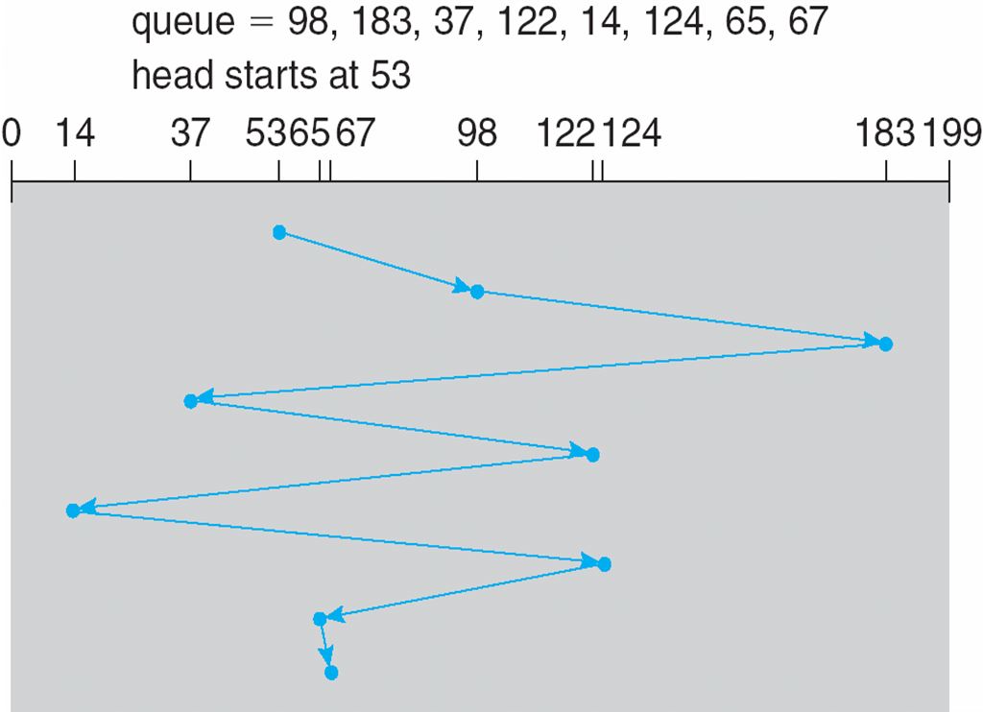
FCFS
Illustration shows total head movement of 640 cylinders

Slide 22
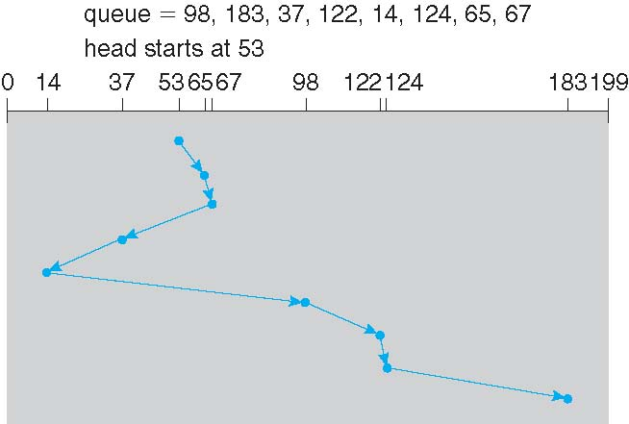
SSTF
Shortest Seek Time First selects the request with the minimum seek time from the current head position
SSTF scheduling is a form of SJF scheduling; may cause starvation of some requests
Illustration shows total head movement of 236 cylinders (vs 640 for FCFS)

Slide 23
SCAN
This approach works like an elevator does. It scans ‘down’ towards the nearest end and then, when it hits the bottom, it scans ‘up’ servicing the requests that it didn't get going down.
SCAN algorithm Sometimes called the elevator algorithm

Slide 24
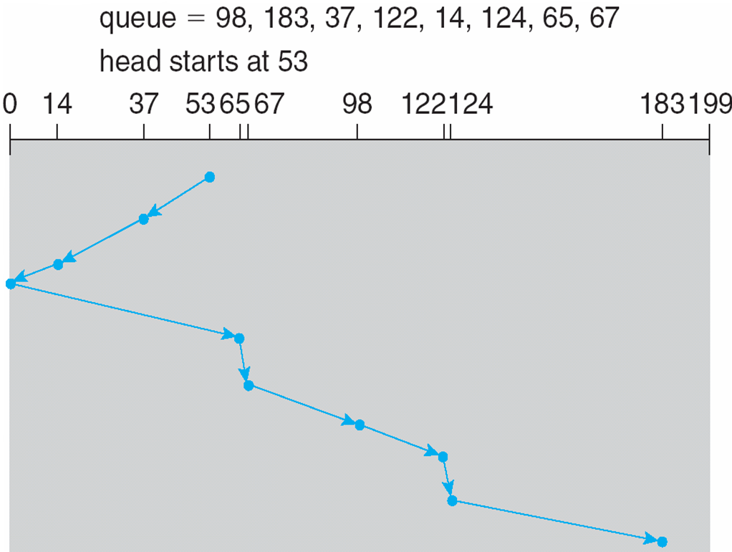
SCAN (Cont.)
total head movement of 208 cylinders

Slide 25
C-SCAN
Provides a more uniform wait time than SCAN
The head moves from one end of the disk to the other, servicing requests as it goes
When it reaches the other end, however, it immediately returns to the beginning of the disk, without servicing any requests on the return trip
Treats the cylinders as a circular list that wraps around from the last cylinder to the first one

Slide 26
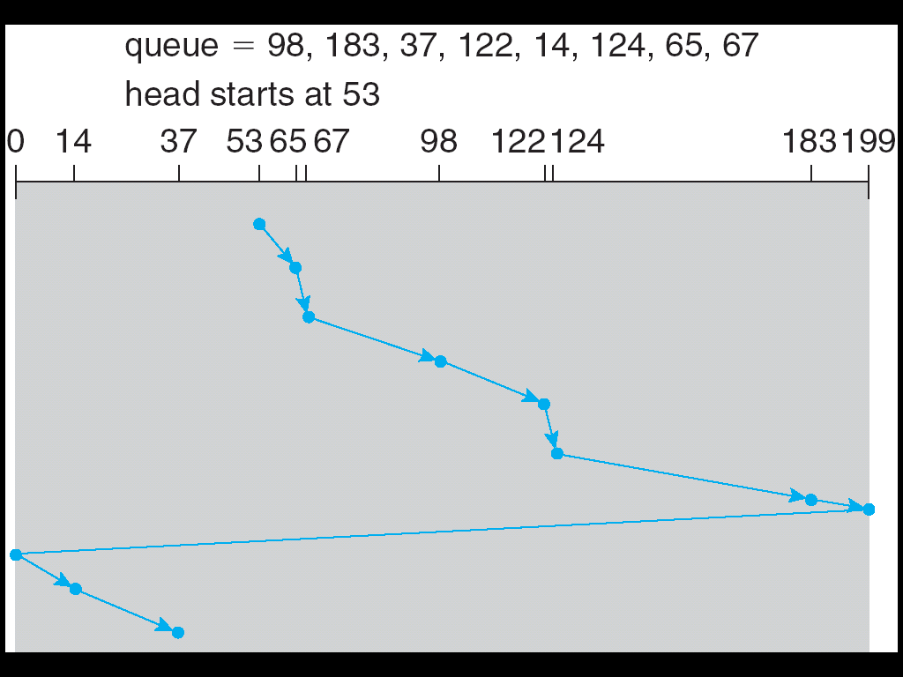
C-SCAN (Cont.)

Slide 27
C-LOOK
LOOK a version of SCAN, C-LOOK a version of C-SCAN
Arm only goes as far as the last request in each direction, then reverses direction immediately, without first going all the way to the end of the disk

Slide 28
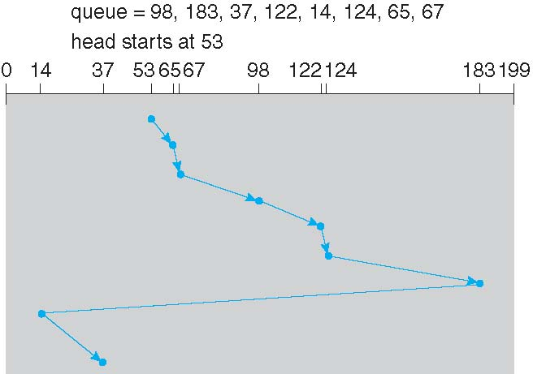
C-LOOK (Cont.)

Slide 29
Selecting a Disk-Scheduling Algorithm
SSTF is common and has a natural appeal
SCAN and C-SCAN perform better for systems that place a heavy load on the disk
Less starvation
Performance depends on the number and types of requests
Requests for disk service can be influenced by the file-allocation method
And metadata layout
The disk-scheduling algorithm should be written as a separate module of the operating system, allowing it to be replaced with a different algorithm if necessary
Either SSTF or LOOK is a reasonable choice for the default algorithm
What about rotational latency?
Difficult for OS to calculate

Slide 30
Disk Management
Low-level formatting, or physical formatting — Dividing a disk into sectors that the disk controller can read and write
Each sector can hold header information, plus data, plus error correction code (ECC)
Usually 512 bytes of data but can be selectable
To use a disk to hold files, the operating system still needs to record its own data structures on the disk
Partition the disk into one or more groups of cylinders, each treated as a logical disk
Logical formatting or “making a file system”
To increase efficiency most file systems group blocks into clusters
Disk I/O done in blocks
File I/O done in clusters

Slide 31
Disk Management (Cont.)
Raw disk access for apps that want to do their own block management, keep OS out of the way (databases for example)
Boot block initializes system
The bootstrap is stored in ROM
Bootstrap loader program stored in boot blocks of boot partition
Methods such as sector sparing used to handle bad blocks

Slide 32
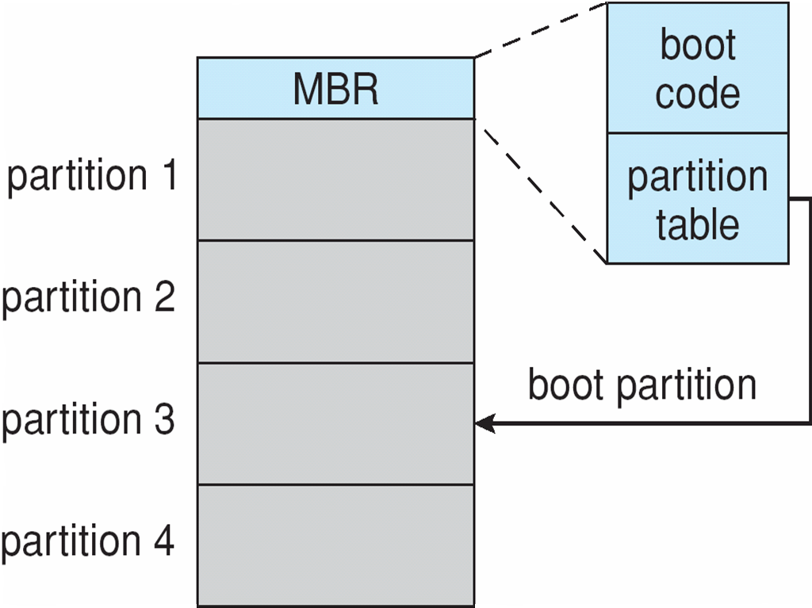
Booting from a Disk in Windows

Slide 33
Swap-Space Management
Swap-space — Virtual memory uses disk space as an extension of main memory
Less common now due to memory capacity increases
Swap-space can be carved out of the normal file system, or, more commonly, it can be in a separate disk partition (raw)
Swap-space management
4.3BSD allocates swap space when process starts; holds text segment (the program) and data segment
Kernel uses swap maps to track swap-space use
Solaris 2 allocates swap space only when a dirty page is forced out of physical memory, not when the virtual memory page is first created
File data written to swap space until write to file system requested
Other dirty pages go to swap space due to no other home
Text segment pages thrown out and reread from the file system as needed
What if a system runs out of swap space?
Some systems allow multiple swap spaces

Slide 34
Data Structures for Swapping on Linux Systems

Slide 35
RAID Structure
RAID – redundant array of inexpensive disks
multiple disk drives provides reliability via redundancy
Increases the mean time to failure
Mean time to repair – exposure time when another failure could cause data loss
Mean time to data loss based on above factors
If mirrored disks fail independently, consider disk with 1300,000 mean time to failure and 10 hour mean time to repair
Mean time to data loss is 100, 000² / (2 ∗ 10) = 500 ∗ 10⁶ hours, or 57,000 years!
Frequently combined with NVRAM to improve write performance
Several improvements in disk-use techniques involve the use of multiple disks working cooperatively

Slide 36
RAID (Cont.)
Disk striping uses a group of disks as one storage unit
RAID is arranged into six different levels
RAID schemes improve performance and improve the reliability of the storage system by storing redundant data
Mirroring or shadowing (RAID 1) keeps duplicate of each disk
Striped mirrors (RAID 1+0) or mirrored stripes (RAID 0+1) provides high performance and high reliability
Block interleaved parity (RAID 4, 5, 6) uses much less redundancy
RAID within a storage array can still fail if the array fails, so automatic replication of the data between arrays is common
Frequently, a small number of hot-spare disks are left unallocated, automatically replacing a failed disk and having data rebuilt onto them

Slide 37
RAID Levels

Slide 38
RAID (0 + 1) and (1 + 0)

Slide 39
Other Features
Regardless of where RAID implemented, other useful features can be added
Snapshot is a view of file system before a set of changes take place (i.e. at a point in time)
More in Ch 12
Replication is automatic duplication of writes between separate sites
For redundancy and disaster recovery
Can be synchronous or asynchronous
Hot spare disk is unused, automatically used by RAID production if a disk fails to replace the failed disk and rebuild the RAID set if possible
Decreases mean time to repair

Slide 40
Extensions
RAID alone does not prevent or detect data corruption or other errors, just disk failures
Solaris ZFS adds checksums of all data and metadata
Checksums kept with pointer to object, to detect if object is the right one and whether it changed
Can detect and correct data and metadata corruption
ZFS also removes volumes, partitions
Disks allocated in pools
Filesystems with a pool share that pool, use and release space like malloc() and free() memory allocate / release calls

Slide 41
ZFS Checksums All Metadata and Data

Slide 42
Traditional and Pooled Storage

Slide 43
Stable-Storage Implementation
Write-ahead log scheme requires stable storage
Stable storage means data is never lost (due to failure, etc)
To implement stable storage:
Replicate information on more than one nonvolatile storage media with independent failure modes
Update information in a controlled manner to ensure that we can recover the stable data after any failure during data transfer or recovery
Disk write has 1 of 3 outcomes
Successful completion - The data were written correctly on disk
Partial failure - A failure occurred in the midst of transfer, so only some of the sectors were written with the new data, and the sector being written during the failure may have been corrupted
Total failure - The failure occurred before the disk write started, so the previous data values on the disk remain intact

Slide 44
Stable-Storage Implementation (Cont.)
If failure occurs during block write, recovery procedure restores block to consistent state
System maintains 2 physical blocks per logical block and does the following:
Write to 1st physical
When successful, write to 2nd physical
Declare complete only after second write completes successfully
Systems frequently use NVRAM as one physical to accelerate

Slide 45
End of Chapter 10

